Slide 1
About Repertoire
Final Project Presentation May 2, 2017

Slide 2
Talk Outline
Questions at end - 15 minutes to cover 6 pages of instructions from Paula on what to include and warning that she will enforce a firm cut-off!!!!! :-)
Will go back and forth between demonstration and slides
What it does (High Level Demo)
How it does it (High Level Slides)
More detail (Demo and Slides)
Particular points of interest (Slides and extemporaneous)
Questions - 5 additional minutes

Slide 3
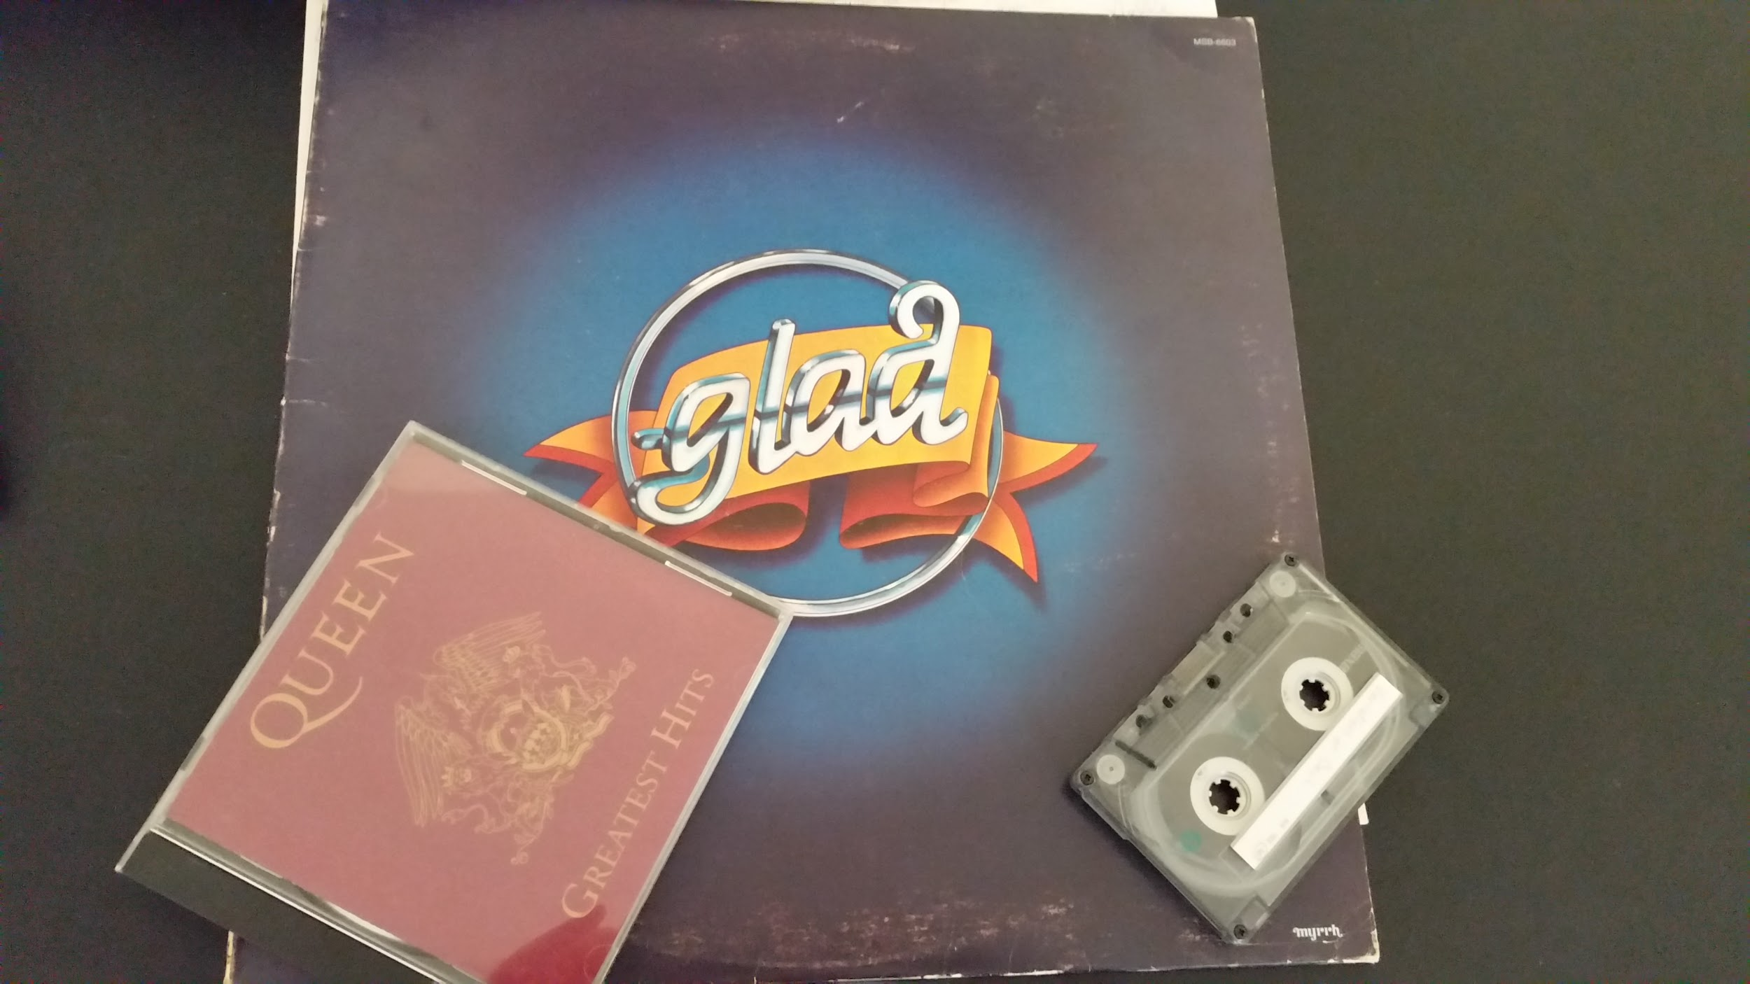
Motivation - Why this Project?
Albums - Do you know what they are?
Personal recordings
Desire to share a sequence of songs with people I love
Don’t know how to do all of these with any currently affordable (or free) service

Slide 4
Hyper-Quick High-Level Demo
Login as jdoe
Create a new playlist 70s
Upload Queen
Go to Manage
Play, skip forward, skip forward, skip back, stop
Share with me
Logout

Slide 5
Hyper-Quick Technology High-Level Survey
Application Environment
Application Connections and Pieces
Development Environment

Slide 6
Hyper-Quick Technology High-Level Survey Application Environment
server
user
MySQL
Tomee Web Support
Repertoire Web Application
internet
device
Computer File Service

Slide 7
Hyper-Quick Technology High-Level Survey Application Connections and Pieces
Servlet Java Classes
Java Server Pages
HyperText Meta Language
JSP Standard Tag Library
Cascading Style Sheets
Repertoire
Hibernate Data Access Objects
Simple Java Objects
internet
Player
HyperText Transfer Protocol
Log4j
JUnit

Slide 8
Hyper-Quick Technology High-Level Survey Integrated Development Environment
IntelliJ
JUnit Testing
Git local version management
internet
Maven build management
Git hub

Slide 9
Quick Technology Medium-Level Survey
Database
POJO
DAO
Player
Error Handling
Validation
Unit Testing
Pure CSS
Planning
Utilization of Comments

Slide 10
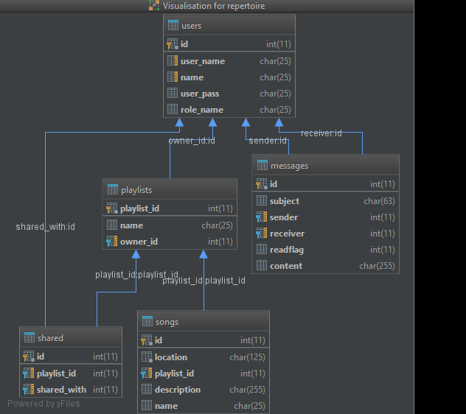
Quick Technology Medium-Level Survey
Database and POJO (Plain-old Java Object)
User PoJO
Int id;
String user_name;
String name;
String user_pass;
String role_name;
//constructor
//get and set methods

Slide 11
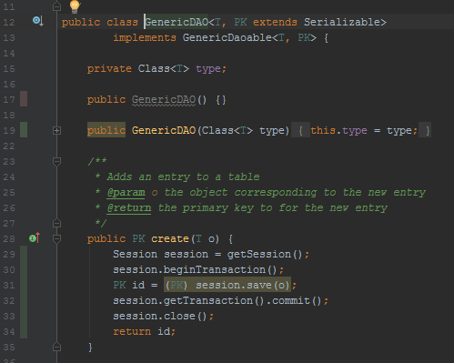
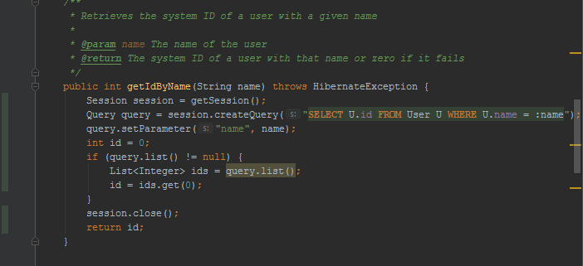
Quick Technology Medium-Level Survey
Data Access Object (thanks to Glenn)

Slide 12
Quick Technology Medium-Level Survey
Player - My “API” requirement
My Three Threads
Found Online
Had to work in Background
Needed Second Background Thread
Play starts threads
Stop terminates thread
Skip stops player, updates current song, and starts new Player
HTTP/User-Oriented Responsive Thread
Creates Player Manager and sets state
Player Manager
Tracks:
Playlist
Current Song
State
Creates and Stops Player
Player
Finds Song
Plays Song
Exits
Play Skip Stop

Slide 13
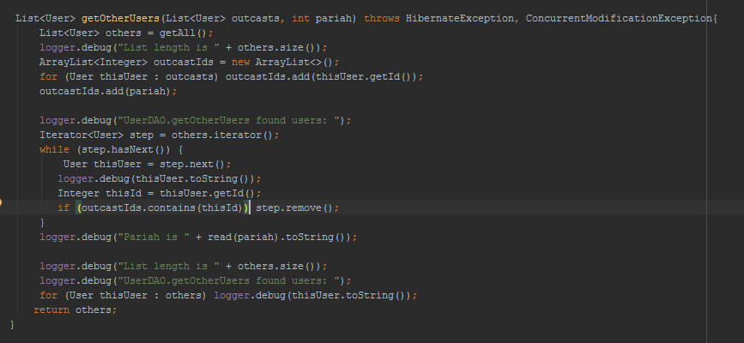
Quick Technology Medium-Level Survey
Error Handling
Exceptions Thrown up to user interface
Other problems recorded to log files

Slide 14
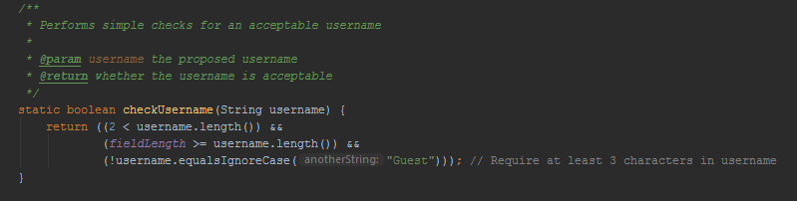
Quick Technology Medium-Level Survey
Validation

Slide 15
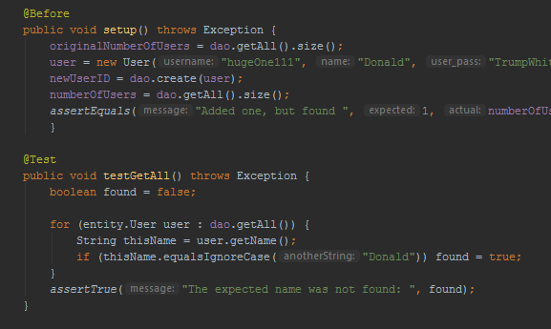
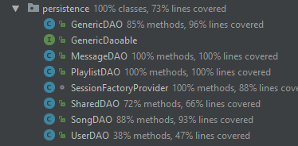
Quick Technology Medium-Level Survey
Unit Testing
Focused on DAO as easiest place to slip up and fundamental to correct function
Covered every method to ensure that each database access is at least mostly correct

Slide 16
Quick Technology Medium-Level Survey
Pure CSS - My Research Topic
Pure CSS is aid to formatting web pages via Cascading Style Sheets
Chosen to make site “not ugly”
Arranges objects by fraction of page width (e.g. ⅓ of page, then ⅓ of page, then ¼)
Utilization of Comments
Learned mostly from web, sites including https://purecss.io/

Slide 17
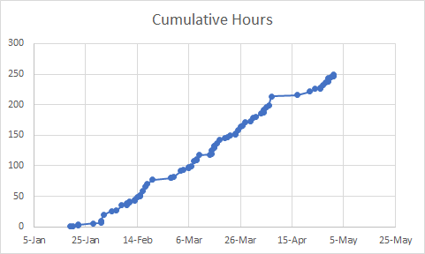
Quick Technology Medium-Level Survey
Planning, Scheduling, etc.
Followed Simple Rule: “Don’t Fall Behind”
Spent 330 hours out of class time on Enterprise Java so far [22 hrs / wk]
will put in a few more this week
255 of these hours were on this project

Slide 18
Quick Medium-Level Demo
Login as me
Add New User
Delete New User
Logout

